Slide 1
Образец для описания внешности.
This is a ________________________________________
Its name is ___________________________________________
Its hair is ____________________________________________
_______ has got ______________________________________
______ eyes are ______________________________________
___________ has got __________________________________
___________ wears ___________________________________
____________________________________________________

Slide 2
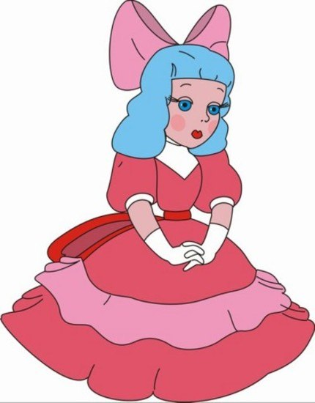
Malvina and Buratino

